Slide 1
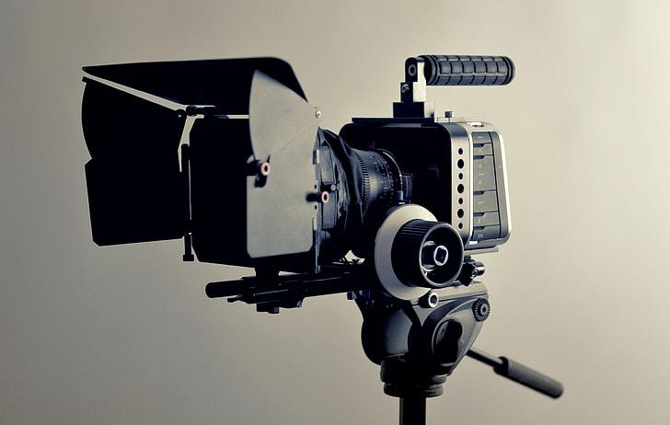
Filmmaking & Technology
Introduction to Research
Kevin Shreenauth

Slide 2
Research Question
How have technological advancements impacted the world of filmmaking, both in the physical hardware used to film motion pictures and the software technologies used in post-production?

Slide 3
Key Definitions
Film Hardware → Camera, Lighting, Audio Equipment, etc.
Film Software → Editing, AI algorithms, CGI, VR/AR, Animation, etc.
Post-Production → Technology used to edit pre-recorded film

Slide 4
Research Objective
To investigate the role technology has in both the physical filmmaking process and post-production softwares in the past, present, and future through the respective technological advancements made and their impacts on the filmmaking process.
Past - film cameras vs digital
Present - CGI/Animation
Future - VR/AR in filmmaking

Slide 5
Hypothesis
Technological advancements in digital cameras, CGI, AI, and various editing softwares have significantly enhanced the filmmaking process by improving the quality and efficiency of production, enabling directors to continue to push the limit of creative storytelling through motion pictures

Slide 6

Research Methods
Literature Review
DataBases used: Ebscohost Academic Search Premier, Google Scholar
Sources talk about:
Physical Filmmaking Advancements
Ang Lee [Evolution - Hulk (2003), Brokeback Mountain (2005), Life of Pi (2012)]
Animation/AI Advancements
AI/Machine Learning [Scripting, VFX scene element identification]
Post-Production Advancements
VR’s possible Application of Post-Production [Virtual Production Editing Tool (VPET)]
Ang Lee

Slide 7


Research Methods (cont.)
Case Study (?)
Reviewing Films that debut certain film tech advancements and detailing how it aided the film?
Avatar (2009) James Cameron
3D motion capture technology
Toy Story (1995) John Lasseter
First full length movie to use CGI in its entirety

Slide 8
Thank you.
Any Questions?

